Slide 1
Global Economics Vocabulary
Economics: The study of how people make decisions in a world where wants are unlimited but resources are limited.

Slide 2
Every country must answer 3 questions:
What is produced?
How is it produced?
Who gets what is produced?

Slide 3
Economic System
The way a country makes decisions about the production and consumption of goods and services.
Different countries have different economic systems.
  Communist System – Government decides.
  Market System – Individuals decide.
  Mixed System – Public (Government) and Private (Individuals) decide.

Slide 4
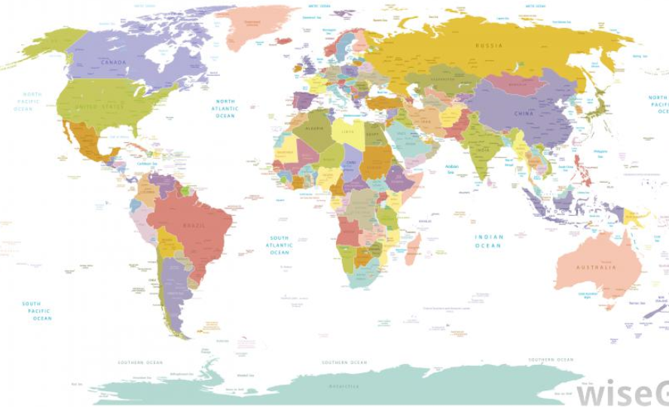
Global Trade
Most countries decide to exchange goods and services across the globe. Why?
  To obtain goods they cannot make on their own because they do not have the natural resources.
  To hired skilled labour that is not available locally.
  To meet people’s demands for wants. Example: cars.

Slide 5
Global Trade
GDP: Gross Domestic Product
A measure of the value of a countries goods and services that are ready to be sold.

Slide 6
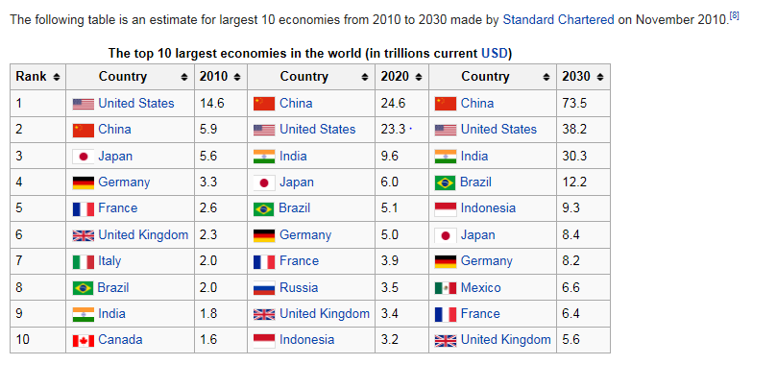

Slide 7
Globalization and free trade agreements
Free Trade Agreement: An agreement between 2 or more countries to trade goods and/or services.
Some people say that “Free trade creates a level playing field”.
But does it??

Slide 8
PROS AND CONS OF TRADE
Cons:
  Exploitation of natural resources and people.
  Environmental and labour abuse due to insufficient laws.
  Rich are getting richer; poor are not getting much better off.

Slide 9
Human Development Index
Measurement of country “development” based on:
  Life expectancy
  Literacy
  Education
  Standard of living
  Quality of life

Slide 10
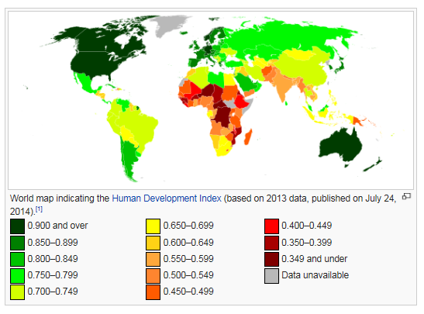
Human Development Index

Slide 11
Conflict Minerals 101
After watching the video, complete the following:
In your own words, write a summary of the problem of conflict minerals in the Congo.
What are the possible solutions to this problem?

Slide 12
PROS OF FREE TRADE
Pros:
  Reduces tariffs (trade taxes) for importing/exporting between countries.
  Reduces likelihood of war due to reliance on each other (as long as they get along!).
  Expanded market for selling goods.
  Countries can specialize in producing specific goods or services.
  Creates jobs based on new businesses.

Slide 13
Santa’s workshop video

Slide 14
“LIVING ON ONE” VIDEO
Watch the video and complete the video sheet.

Slide 15
CONS OF FREE TRADE
Cons:
  Who is responsible for making sure there are resources left for future generations??
  Some countries have corrupt government or high levels of organized crime.
  All countries have poverty but some countries have much higher levels of poverty due to drought, war, etc.
  Focus on PROFIT only.
  Developing countries are EXPLOITED.
    Exploited: To take advantage of poverty, no environmental laws, unfair labour practices.

Slide 16
Helping developing countries
Three ways to approach:
Exploit.
    “Paying them 20¢ per day is better than nothing.”
    Condones unfair labour practices.
Hand out.
    Provide aid ($).
    Teaches reliance on other countries.
    Good for emergency situations but not long term.
Hand up.
    Provide fair wages based on cost of living.
    Provide knowledge and technology (equipment) and teach sustainability.

Slide 17
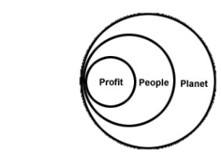
Reflection
What does this diagram suggest to you about the “value” of each of these elements?
Does the diagram accurately describe our current system of living? Why or why not?

Slide 18
Social Responsibility in Business
Ethical: The act of “doing the right thing”.
Sustainable: Something that can last over a long time.
Social Responsibility: The idea that businesses should be about more than profit; that business has a responsibility to be ethical and sustainable.
People, Planet, Profit: 3P is a business model in which people and planet are seen as just as important or more important than profit.

Slide 19

Global trade recap so far
In a “perfect” world there would be one big market and everyone would have equal opportunity to earn a reasonable living.
However, there are some inequalities that currently make that impossible:
Level of country development.
Level of government instability or organized crime.
Some countries have few or no laws to protect the environment, animals, and people.
All countries have some poverty; but some countries have very high levels of poverty.

Slide 20
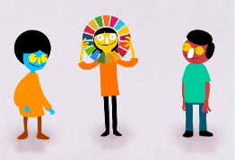
YOU ARE A GLOBAL CITIZEN
WHAT DOES THAT MEAN TO YOU?

Slide 21
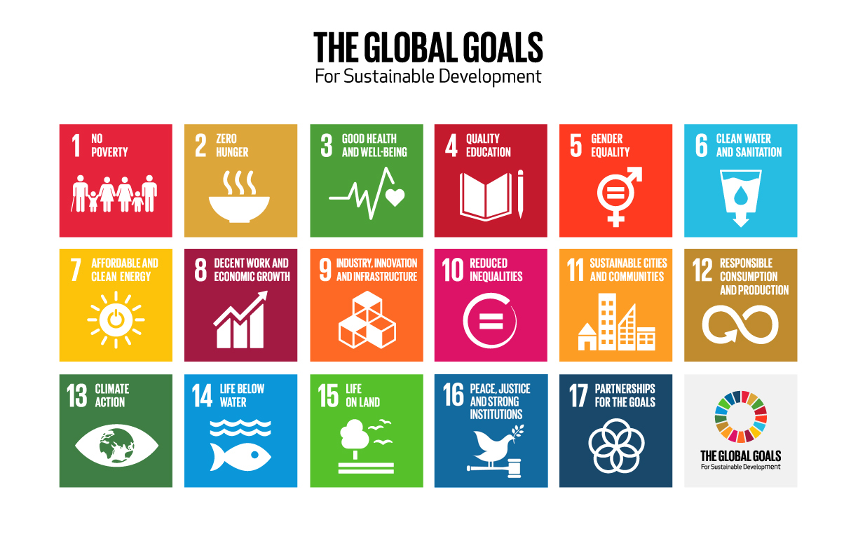
United nations 2030 sustainability plan

Slide 22
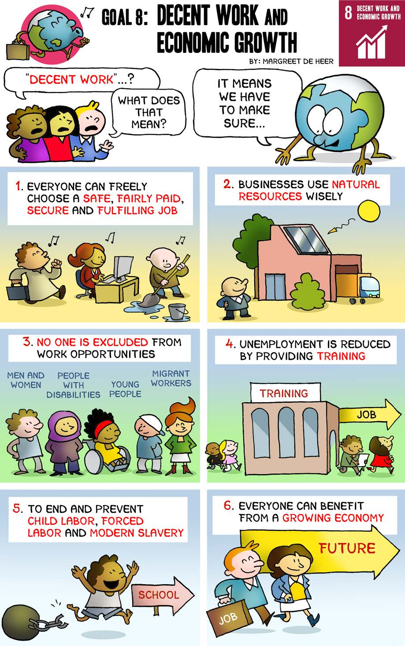

Slide 23

Social Responsibility in Business
Fair Trade: A business model which aims to improve trade conditions for producers. The Fair Trade label certifies that:
Producers have been paid a fair wage.
Product is produced in an environmentally friendly way.
No child labour.
Premium is paid to the community to improve health and education.

Slide 24
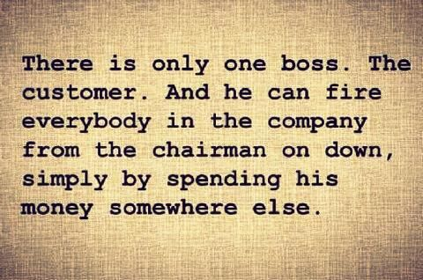
Social Responsibility in consumers
“Vote with Your Dollar”: Consumers “vote” for a company when they buy products from them.
What are some ways that consumers can become more powerful?
What can consumers do to influence businesses to be more ethical?

